Slide 1

Bank Campaign Success Prediction
Team : Great Mates
Anvesh Pendli (apf9v@umsystem.edu)
Rakesh Rao Thakkalapelly (rthf8@umsystem.edu)
Bharath Kumar Pasunoori (bphnt@umsytem.edu)
Pavan Kumar Kondamuri (pkzym@umsystem.edu)

Slide 2
Problem Statement:
We are given the data of the direct marketing campaigns of a banking institute. The goal is to predict if the client will subscribe to the term deposit.
Objective:
We will try to analyze the digital marketing data of a Bank and will try to predict whether a particular customer will subscribe to a term deposit. Here in this, we have used UIC Data. In this data we have 16 independent variables we will try to analyze the impact of the variable on the user subscription and choose the best model for better prediction.

Slide 3
Data Set Description:
The Data set consist of 16 Columns and 45211 Rows
Source:
UIC Machine Learning Data
https://archive.ics.uci.edu/ml/datasets/Bank+Marketing#
Data Exploration:
In the given dataset we have 10 Categorical values, 6 numerical values and one binary value.

Slide 4
Data Cleaning
For cleaning the dataset, we have used Pandas Module which is available over Python Language and have dropped all the rows which have the Null values.
We have written the new data without any null values into a new file and this file has been used as an input for further analysis.
import pandas as pd
df = pd.read_csv("bank-full.csv")
df1=df.dropna()
df1

Slide 5
Before we will be able to apply machine learning techniques, we should prepare the dataset for processing:
Convert columns with 'yes' and 'no' values to boolean columns;
Convert categorical columns into dummy variables.

Slide 6
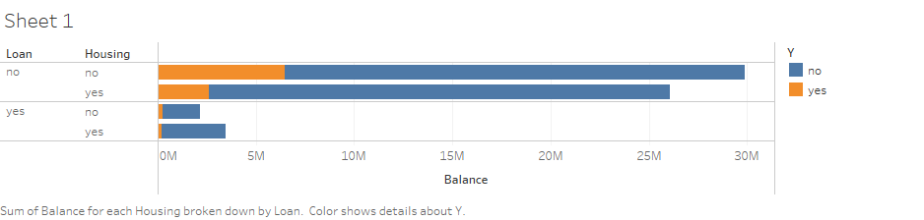
Data Visualization:
Impact of Loan on the Campaign Success
In the plot we can clearly see that the loan of the person has been an impactful input which will affect the outcome of the campaign.
The person without any loan can be preferrable candidate.

Slide 7
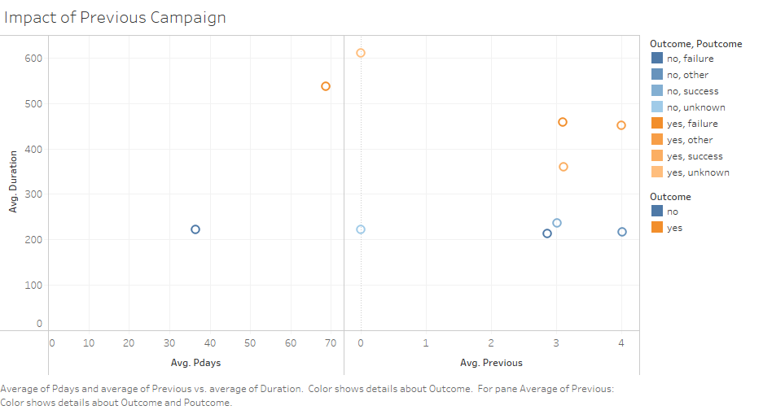
Impact of Previous Campaign
From the analysis we can see the following observations
Average Pdays for a successful campaign is 70
Average duration of a call for a successful campaign is 537
most of the successful outcomes are from the campaigns which average duration of call more than 300 seconds.

Slide 8
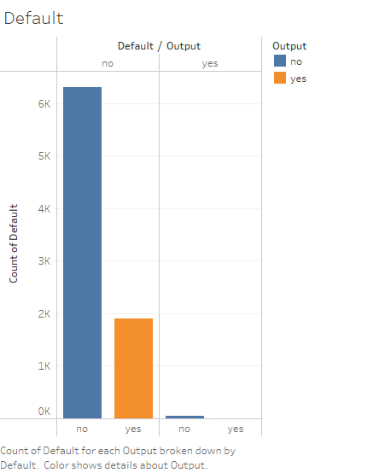
Impact of Loan Default
From the insights we can see that the persons with no credit default has been a first better choice.

Slide 9
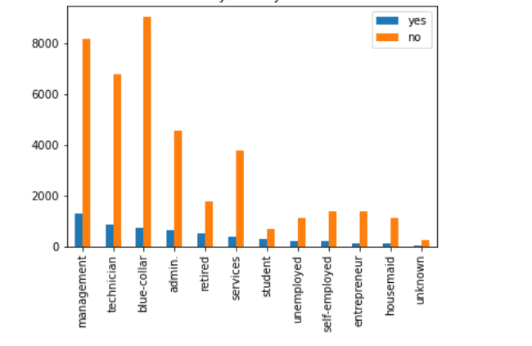
Impact of Job
We can find out that the success rate of subscribing for a campaign is high for the people with job type
  Management
  Technician
  Admin.
We can also consider the blue-collar job people but due to low success rate this can be added to low priority target audience.

Slide 10
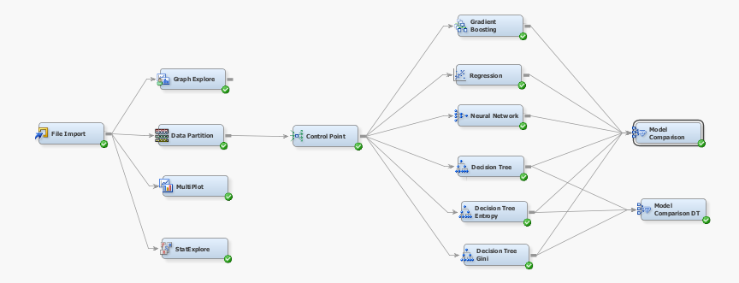
Model Diagram

Slide 11
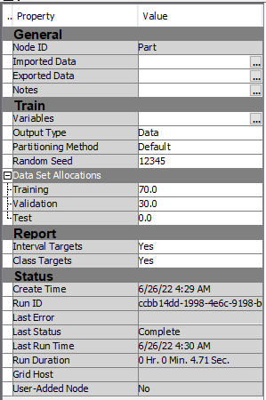
Data Partition
We have splitted our data into
  70% of data for training
  30% of data for validation

Slide 12
Decision Tree:
Decision Tree is a Supervised learning technique that can be used for both classification and Regression problems, but mostly it is preferred for solving Classification problems.
It is a tree-structured classifier, where internal nodes represent the features of a dataset, branches represent the decision rules and each leaf node represents the outcome.
It is a graphical representation for getting all the possible solutions to a problem/decision based on given conditions.

Slide 13
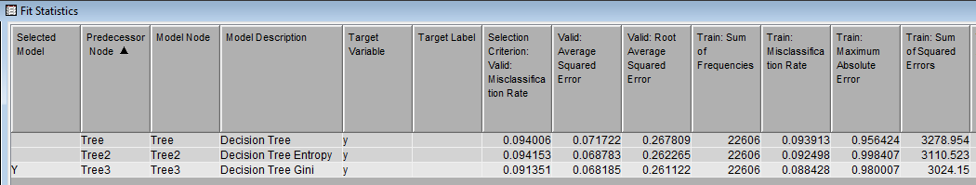
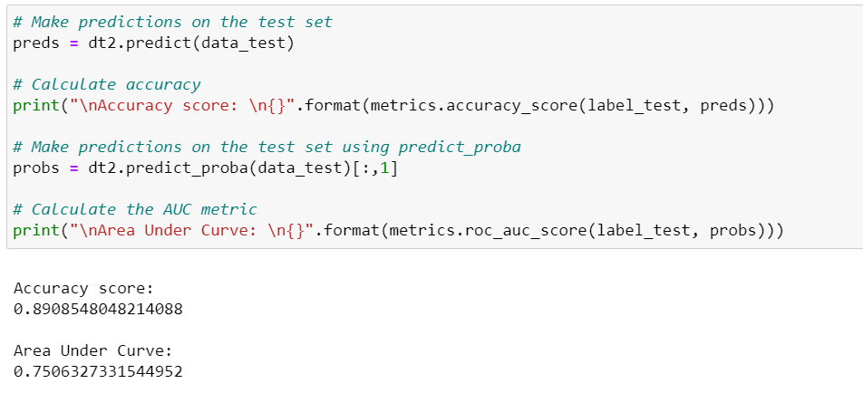
Results:
From the Output we can observe that the Decision Tree Accuracy score is (0.890854)
The Area under curve is (0.750327)

Slide 14
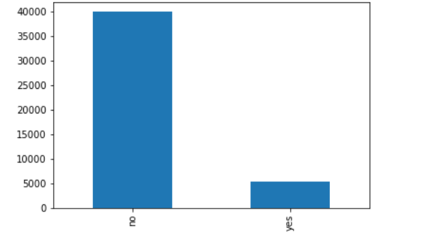
Interpretations and Findings of Model:
Graph Exploration
From this we can observe that most of the output which is available is skewed.
The skewed output means that there are a lot of no’s than the yes.

Slide 15
Recommendations:
We can summarize with the available data we have found some insight able impacts of the different inputs on the outcome and from the exploration we can suggest
  that Married person who has completed education till secondary or territory with no default of banks loans with whom the engagement of the call is more 300 seconds has the more chances of a successful outcome of the campaign.
We can suggest to the bank that they need to try to increase the engagement with customer which in turn increase the subscription rate.

Slide 16
Summary and Lessons Learned
From the Graph Exploration we can find out that our data is highly skewed, and this highly skewed data will affect the output.
Our model can be in a better position to predict the future outcomes if we have diverse set of data, and we need to collect data from which we can form the co-relations among them

Slide 17
Future Extensions:
As we have some good amount of data regarding this case, we would like to add more columns namely Family Assets, Parents Financial condition, Dependencies of the person.
With proper data we can build the models which can have higher percentage of prediction rate.

Slide 18

Thank you !!!

